Slide 1

Machine Learning With AWS SageMaker
Rajesh Sharma
Let’s Dive

Slide 2
Contents
What is Machine Learning?
Machine Learning Process
What is AWS SageMaker? And,
Its main features
Services under its umbrella
SageMaker Notebook Instances
Elastic Block Storage Unit
Elastic Inference
How SageMaker works under the hood?
Built-in algorithms
Demo
Some additional features
References

Slide 3



What is Machine Learning?
ML means empowering computers to perform tasks with full precision and without any human intervention in no amount of time.
Example1 - If you have 10K credit card transactions and asked to find out fraudulent ones then how much time will it take to do it manually? Imagine if every minute 1K transactions are happening then how much human effort will be required to trace fraud transactions.
Thus, we use the computation power of computers to train the mathematical algorithms for performing such and other similar tasks.
Hi, I’m Jimmy
Jimmy uses ML
Example2
Step-1
Step-1
Step-2
Step-2

Slide 4
Machine learning process
Data Re-collection
Any Problem
Feature Augmentation
Monitor
Model
Outcome Validation
Do you have data?
Exploratory Data Analysis
NO
Problem can’t be solved
ML Algo’s
YES
Feature Engineering
Outcome
ML Problem Framing
Data Integration
Split
Data
Model Training
Model Deployment
Data Collection
ML Algo’s
Model Evaluation
Pre-Prod
Validation
Data Augmentation
Data Preparation
Are Goals met?
NO
YES

Slide 5
What Is SageMaker & it’s Features?
Amazon SageMaker is a fully managed machine learning service that enables data scientists and developers to quickly build and train ML models, and then deploy them into a production environment.
It provides an integrated Jupyter notebook instance for easy access to the data sources for exploration and analysis.
We deploy the models by launching it with a few clicks from its console.
Training and hosting are billed by minutes of usage with no minimum fees.
Features
AWS SageMaker Studio
Managed EC2 Notebook Instance
Life cycle configuration
EBS Volume size
IAM Role Assignment
GIT Integration
Elastic Inference
Built-in algorithms
Training jobs
Hyper-parameter jobs
Model Endpoints

Slide 6
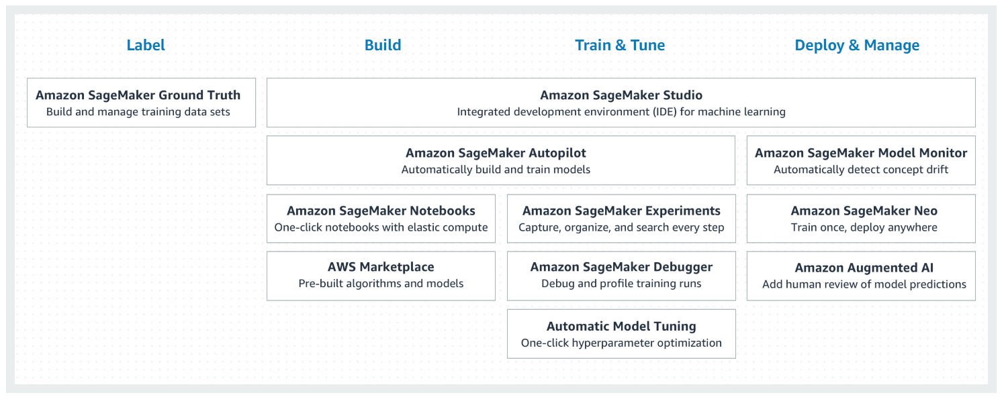
AWS SageMaker Umbrella

Slide 7
SageMaker Notebook Instances
SageMaker EC2 Notebook Instances are the fully managed Jupyter notebooks by Amazon, thus we will not see them in the our EC2 console.
Some of its properties:
Choose the right family
{t, m, c, p}
t represents tiny
m represents more cores & more memory
c represents compute optimized
p represents GPU
Choose the right size
medium, large, xlarge, 2xlarge, ….
Choose the right version
ml.t2.medium
Elastic Compute Cloud (EC2)
Instance

Slide 8
EBS Volume Addition
Each SageMaker EC2 Notebook Instances has an associated EBS volume for code and other components storage. Again, these are also fully managed by Amazon, thus we will not see them in the our EBS dashboard.
Some of its properties:
Choose the right size
5 GB is the default storage size
Directory or folder location
/home/ec2-user/SageMaker
Git Integration
Add or create git repository
Use Lifecycle configuration
Install packages or copy data while creating/starting notebook
Security settings configuration
IAM role
Root level access
Encryption
VPC connection
Elastic Compute Cloud (EC2)
Instance
Elastic Block Storage (EBS) Volume

Slide 9
Elastic Inference
Elastic Inference
Elastic Compute Cloud (EC2)
Instance
Elastic Block Storage (EBS) Volume
Elastic Inference (EI) speed up the throughput and decrease the latency of getting real-time inferences from your deep learning models that are deployed as Amazon SageMaker hosted models, but at a fraction of the cost of using a GPU instance for your endpoint.
EI allows you to add inference acceleration to a hosted endpoint for a fraction of the cost of using a full GPU instance.
Add an EI accelerator in one of the available sizes to a deployable model in addition to a CPU instance type, and then add that model as a production variant to an endpoint configuration that you use to deploy a hosted endpoint.
Available sizes: ml.eia1.medium, ….. , ml.eia2.xlarge

Slide 10


SageMaker Under The Hood?
Input Data
Response
Amazon SageMaker
Model
End point
Model Artifacts
Deployment/Hosting
opt/ml/ WORKDIR/
model/ nginx.conf
predictor.py
serve
wsgi.py
Amazon
Elastic Container Registry
WORKDIR/
nginx.conf
predictor.py
serve
train
wsgi.py
Jobs
Model
Testing
Model Training
opt/ml/ WORKDIR/
input/ train
model/
code/
output/
Training Data

Slide 11
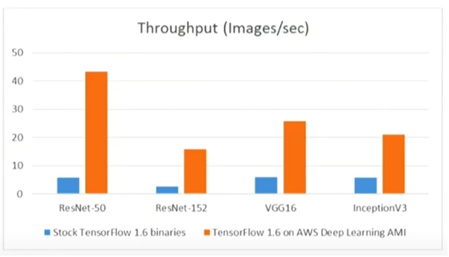

SageMaker Built-in Algorithms
Classification
Linear Learner
XGBoost
KNN
Working with Text
Blazing Text
Supervised
Unsupervised
Regression
Linear Learner
XGBoost
KNN
Clustering
Kmeans
KNN
Computer Vision
Image classification
Object classification
Feature Reduction
PCA
Object2Vec
Amazon has provided the 100+ Jupyter notebook examples explaining how to use the built-in algorithms. And, these algo’s are also trained on some real life dataset.
Anomaly Detection
Random Cut Forests
IP Insights
Forecasting
DeepAR

Slide 12
Demo
Jupyter notebook instances
Lifecycle configuration
Git integration
Ebs access
Elastic inference
Model Training job
Model endpoint
Classification USE CASE example DATASET??

Slide 13





Some Additional Features
Training
Code
Built-in
Algorithms
External Framework
External Docker Container

Slide 14


Slide 15
References
https://docs.aws.amazon.com/sagemaker/latest/dg/whatis.html
https://docs.aws.amazon.com/sagemaker/latest/dg/how-it-works.html
https://docs.aws.amazon.com/sagemaker/latest/dg/gs-set-up.html
https://aws.amazon.com/sagemaker/
https://docs.aws.amazon.com/sagemaker/latest/dg/studio.html
https://docs.aws.amazon.com/sagemaker/latest/dg/processing-job.html
https://www.youtube.com/watch?v=uQc8Itd4UTs&list=PLhr1KZpdzukcOr_6j_zmSrvYnLUtgqsZz&index=1
https://www.youtube.com/watch?v=sLktFah2Xi4
Image Links
https://www.netclipart.com/isee/TwRbxR_cartoon-robot-png-cartoon-robot-clip-art/
https://www.vectorstock.com/royalty-free-vector/trekking-boy-vector-4433260
https://events.williams.edu/event/join-csac-chemistry-student-advisory-committee-on-saturday-july-20th-for-a-short-morning-hike/
https://www.google.com/url?sa=i&url=https%3A%2F%2Fwww.pinterest.ca%2Fpin%2F123145371040439613%2F&psig=AOvVaw0Z-U5JCZGeArwV2sntT5wI&ust=1590577256988000&source=images&cd=vfe&ved=0CAMQjB1qFwoTCKCouJuw0ekCFQAAAAAdAAAAABBb

